Slide 1

Predicting Student Pass/Fail Rates
Benjamin Mauldin Northwood University Aldie, VA, USA mauldinbm42@northwood.edu
MGT 665

Slide 2


The rise of the online classroom

Slide 3
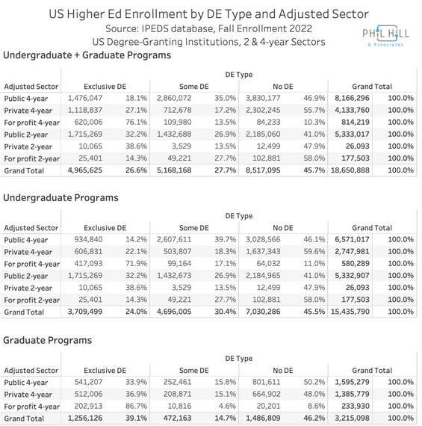
The rise of the online classroom

Slide 4

Learning Analytics

Slide 5

Learning Analytics (and this project)

Slide 6
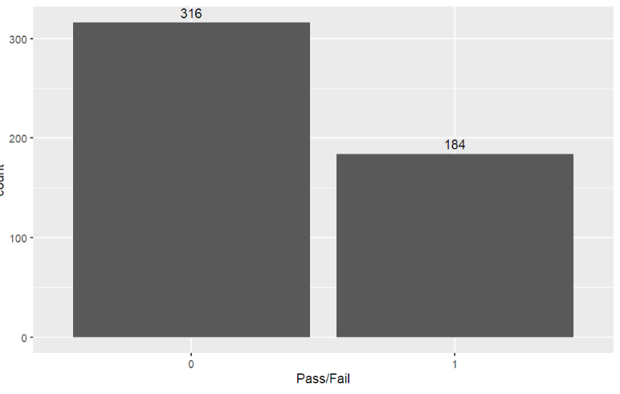
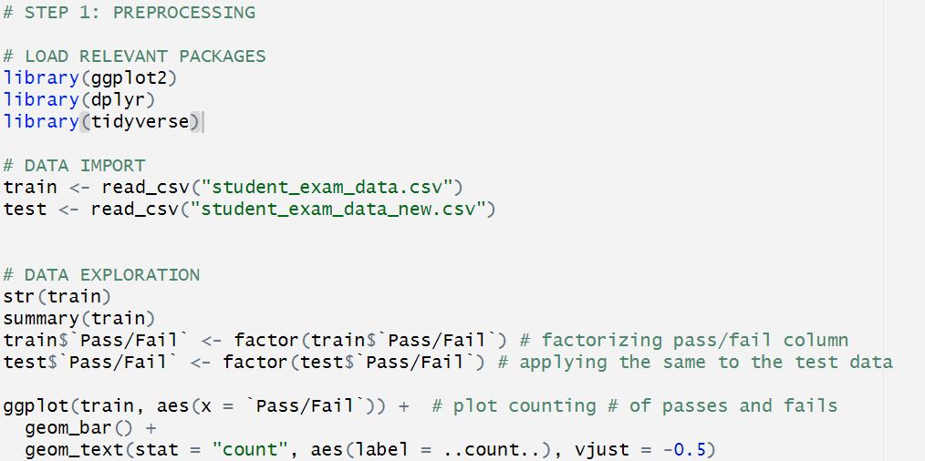
Pre-Processing

Slide 7
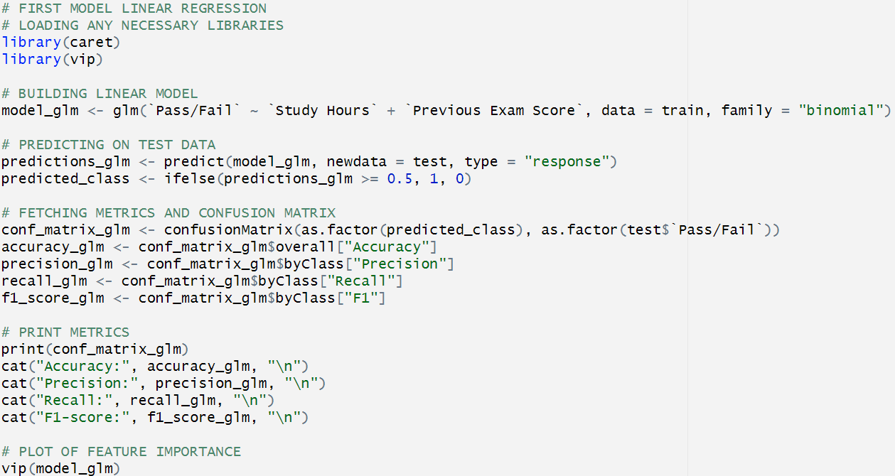
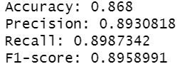
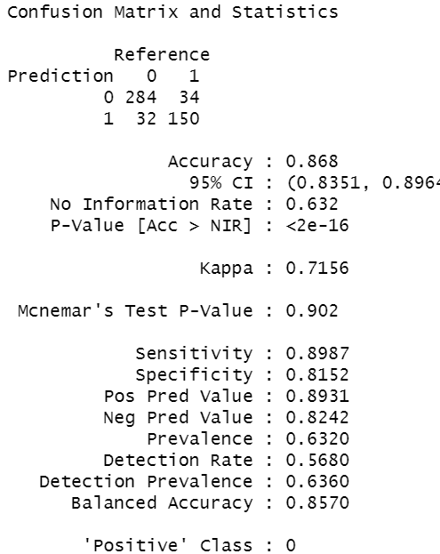
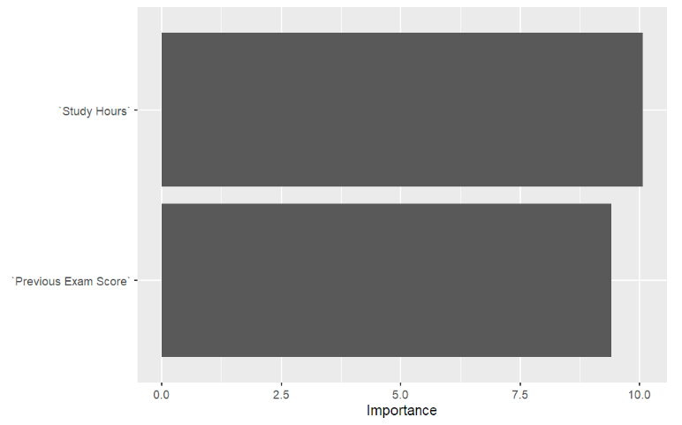
Logistic Regression

Slide 8
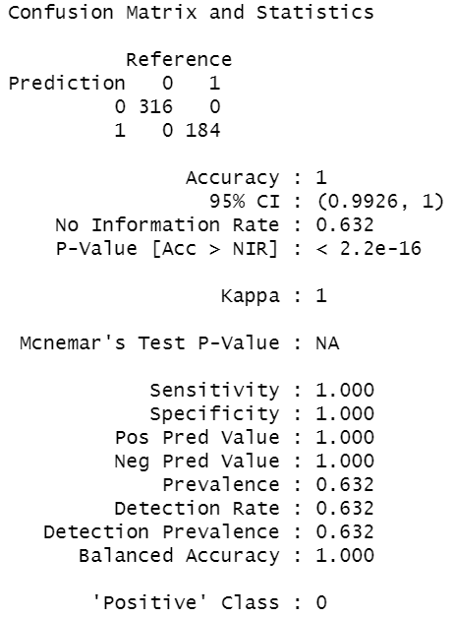
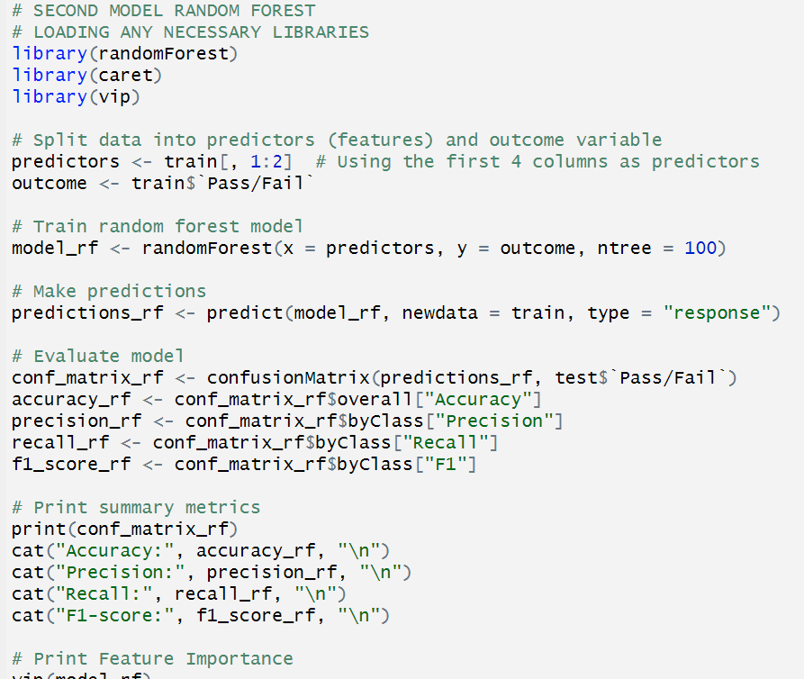
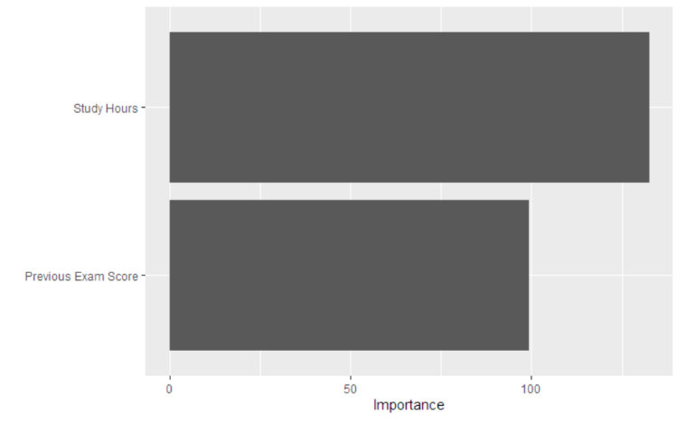
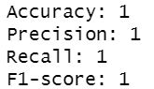
Random Forest

Slide 9
References
[1] NCES. (2022, August). US Education in the time of COVID. National Center for Education Statistics. https://nces.ed.gov/surveys/annualreports/topical-studies/covid/
[2] Hill, P. (2024, January 21). Fall 2022 IPEDS Report. On EdTech Newsletter. https://odnedtech.philhillaa.com/p/fall-2022-profile-us-higher-ed-online-education
[3] Lantz, B., Carchedi, N., & Solomon, N. (n.d.). Supervised Learning in R: Classification. DataCamp. https://app.datacamp.com/learn/courses/supervised-learning-in-r-classification

